Slide 1


Slide 2
Student Management System

Slide 3
GROUP MEMBERS
1)
Muhammad Subtain Haqani Awaisi
2)
Abdul rehman Imtiaz

Slide 4
About Project
Student management system as the name indicates will be used for managing students records will be used for various purposes. Accepting correct data will results in generating the desired output in correct format without any delay.

Slide 5
Content in project
File handling has been used for the effective implementation of all the typical features of this project. The key features of Student Report Card System are

Slide 6
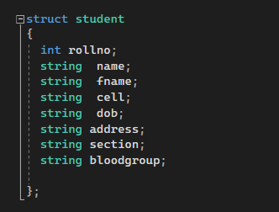
STRUCTURE
Structure is a collection of variables of different data types under a single name. It is similar to a class in that, both holds a colleciton of data of different data types.
Its is use for easy access.
Following are the members of structure:
Name 5. Address
2. Father name 6.Section
3. Cell phone number 7. Blood Group
4. Date Of Birth

Slide 7
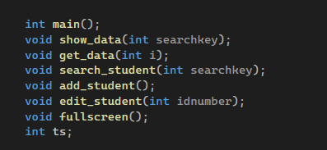
Functions
A function is a block of code that performs some operation. A function can optionally define input parameters that enable callers to pass arguments into the function. A function can optionally return a value as output.
The function we used in our code are following:
1. get_data 4. add_student
2. show_data 5. edit_student
3.search_student

Slide 8
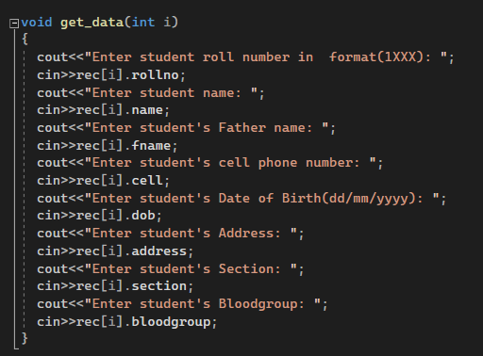
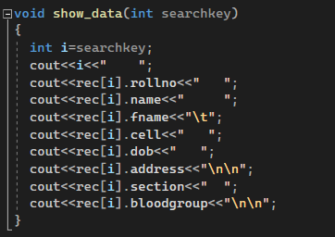
Get and show data function
get_data function: get_data function allow
us to take input from the user.
Input of the members of the structure.
2. show_data: This function help us to display
data on the console.

Slide 9
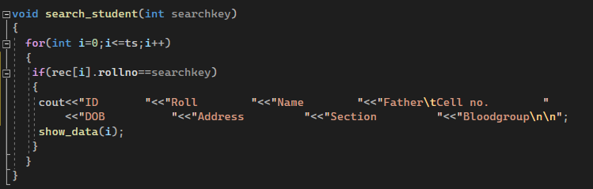
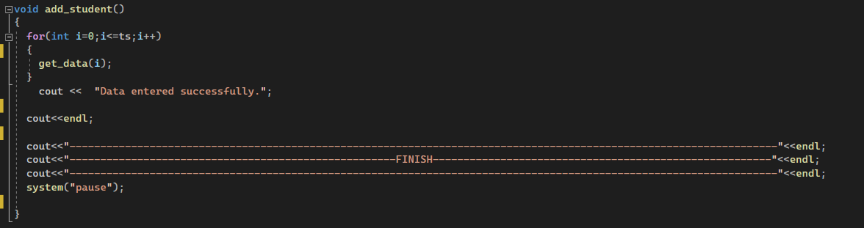
Search and add student function
Search student: This function help us to find data of a particular student with the help of their roll numbers.
Add data: This function help us to add information of the new student.

Slide 10
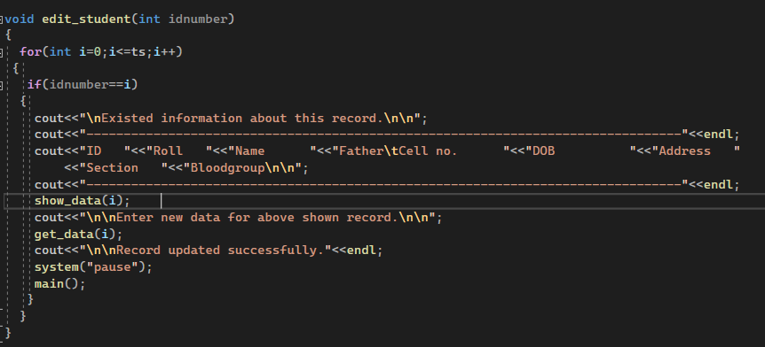
Edit student function
edit student: This function allows us to change the information of the a particular student by using the id number of the student.

Slide 11
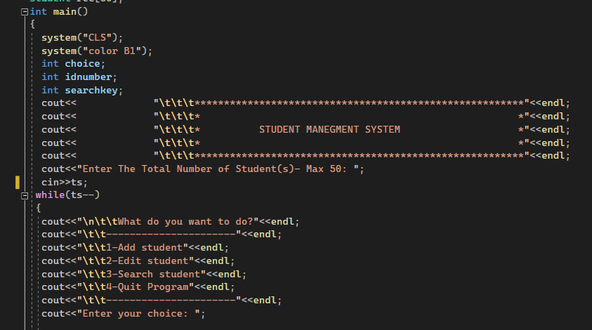
Main function
The function on which our whole code is based upon. This function contain a menu that help us to specify which function we are going to operate on console by entering choices.

Slide 12
THANK YOU!

